Slide 1

Student Success Management
A Comprehensive System to Grow Enrollment, Improve
Retention and Degree Completion
EAB Navigate

Slide 2
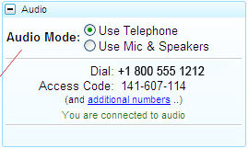
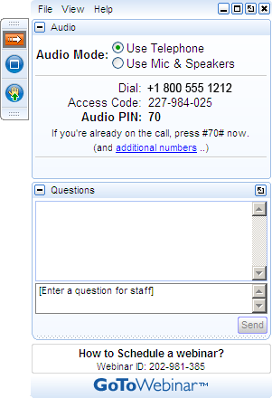
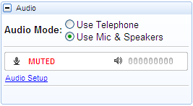

Navigating GoToWebinar
Managing Your Audio and Screen
Using Your Telephone
Asking a Question
If you select the “Use Telephone” option, please dial in with the phone number and access code provided.
To ask the presenter a question, type it into the question panel and press send.
Using Your Microphone and Speakers
If you select the “Use Mic & Speakers” option, please be sure that your speakers or headphones are connected.
Minimizing and Maximizing Your Screen
Use the orange and white arrow
to minimize and maximize the GoToMeeting panel.
Use the blue and white square to make the presentation full screen.
Notes:
GTW Overview – Kelly
Before we get started, I want to do a quick review of the GoToWebinar functionality for those new to the technology…
There are two ways for you to listen to the audio of this webinar: through your phone or your computer speakers
If you’re listening through your phone, be sure to select that option in the panel and dial into the conference line number provided.
If you prefer using your computer speakers, you can select that option as well…
Either way – I suggest you go hands-free to have hands to take notes!
You are all placed in Listen Only mode to minimize background noise on the line…
However, we still encourage you to listen actively and ask questions…if you have a question, please type it into the question section in the GTW panel, and we’ll either stop to answer questions or save it to the end.

Slide 4
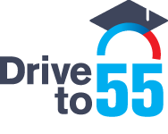



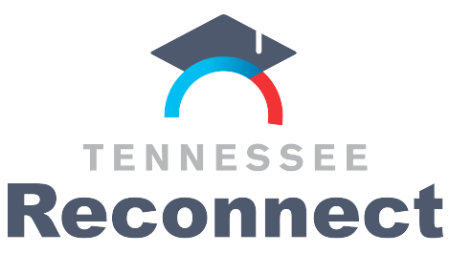





More Than A Strong ‘Drive’ Needed to Increase Student Completion
Community-Led Accountability and Advocacy Essential to Reach Key Populations
Grant Programs Focus on Individuals Across Various Life Stages
However More Support is Needed
Closing Gaps in Tennessee
Despite tackling college access head-on, challenges remain in Tennessee as the state grapples with decreasing adult student enrollment and an achievement gap for African-American students.
32%
55%
2013
2025
Increasing the percent of Tennesseans with a college degree or credential
Lawmakers to focus on community college scholarships in 2018 session
High School Graduates
Adult Learners
Specific Population Outreach and Support Crucial to Reach Goal
Low–income students
African-American
Scholarship and mentoring
Scholarship
Adult learners/parents
Concurrent Initiatives include TN Leap, Pathways and eCampus
Source: Tennessee Higher Education Commission, Beneath the Surface: The State of Higher Education in Tennessee, https://static1.squarespace.com/static/56cf531db6aa6036fa14e1f8/t/5a2f284a24a694abf96ca2f8/1513040124477/Beneath+the+Surface_State+of+Higher+Education+in+Tennessee_2017.pdf, EAB interview and analysis.

Slide 5






EAB’s Promise to Tennessee: Improved Student Success Outcomes
Current State Membership
EAB Members
Campus

Slide 6






Missing an Opportunity to Get Ahead of the Onboarding Problem
Complex Onboarding Process Makes It Too Easy for Students to Get Discouraged and Opt Out of Enrollment
Administration’s perspective of how onboarding works
College Application
Financial
Aid
Placement Tests
Advising
Orientation
Registration
Day One of Class
Students’ real experiences can often be far
more complex
Complex process produces a myriad of consequences for the student:
Frustration with the institution
Weak sense of goals for college
Underplaced in courses
Poor-fit or non optimal schedule
Delayed financial aid awards
Drop out before day one of class
Apply to College
Accepted
Advising Center
Testing Center
Multiple trips to campus
Multiple trips to same office
Missed steps in the process
Parking Services
Orientation
Financial Aid
Student Services
Register
Payment Center
Day One of Class
Source: EAB interviews and analysis

Slide 7
Tons of Opportunity to Grow and Improve
Widening the Recruitment Funnel Can Only Do So Much Until We Fix the Full Pipeline
For Every 100 Students Who Apply to a Two-Year School…
56
Lost during onboarding¹
23
Drop out
of college
5
Still enrolled after six years
9
Complete
an associate degree
7
Complete
a bachelor degree
Source: Source: Shapiro D, et al., “Completing College: A National View of Student Attainment Rates – Fall 2010 Cohort (Signature Report No. 12)” National Student Clearinghouse Research Center (2016); EAB interviews and analysis

Slide 8








Digital Platforms Can Help Many More Students Stay on Path
But Universities Must First Learn How to Fully Leverage Next-Gen Modalities
Blunt Approaches to Digital Communications Miss the Mark with Students
Generic e-mails are easy to ignore and often use an cold, administrational tone
Online portals are passive and organized around budget lines, not student needs
University apps are often just mobile versions of the passive university portal
Today’s Students Demand Support That Is Proactive, Customized, and Delivered Just in Time
8 years of research 250 student interviews 9,000 student surveys
Onboarding and Orientation
Campus Engagement
Academic Support
Major Exploration
Career Preparation
Student Finances
Logistics and Paperwork
Escalate to
Specialists
Notify
When Off Path
Connect with Resources
Define a Customized Path
Proactively Prompt Actions
Validate When Back On Path

Slide 9
How the Best Schools Are Reorganizing Their Student Success Efforts
Technology Is Allowing Schools to Get the Most Out of Scant Resources Via a Differentiated Care Strategy
STAFF-FACING TECHNOLOGIES
Cross-College Care*
Tech-enabled system supports coordinated collaboration between advising, support offices, and faculty around the highest-risk cases
Managed
Interventions
Advisor effort
Proactive
Monitoring
Targeted Outreach Campaigns
Mass communication tools empower support offices to connect with students, ensure requisite steps are completed, and manage risk behaviors in real time
Preventative
Care
(* Most common starting points)
On the Horizon:
Guided Onboarding
Streamlined step-by-step guidance students can complete online
Guided Pathways*
Modules for course planning and automated schedule building
Mobile Guidance
Customized support
that extends advising
and drives engagement
Executive Analytics
Dashboards and reports providing unprecedented visibility into student progress and college operations
STUDENT-FACING TECHNOLOGIES
Source: EAB interviews and analysis

Slide 10
The Evolving Advisor
Moving Beyond Transactional Responsibilities to Provide More Holistic Care
Traditional Professional
Academic Advisors
Next-Generation Student Success Advisors
  Student Success
  Early alert response
  Case management
  Registration
  Financial
  Well-Being
  Registration
  Course planning
  Program guidance
  Student
  Success
  Specializations
  First-year seminars
  Personal counseling
  Financial advising
  Career advising
  Career Preparation
  Academic
  Performance
Source: EAB interviews and analysis

Slide 11

Introducing EAB Navigate
475+ Colleges and Universities Sharing Insights and Resources to Address the Student Success Challenge
Navigate is powered by EAB’s
Student Success Management System integrating all necessary point solutions
Product innovation based in research, driven by members
Research
Proven best practices to help leaders drive change management
Onboarding Module
Dynamic Student Success Pathway
Academic Planning
Course Scheduling and Registration
Consulting
Technology
Early Academic Alerts
Appointment Scheduling
Case Management
Strategic, customized approach to implementations and support
Business Analytics
Source: EAB interviews and analysis

Slide 12
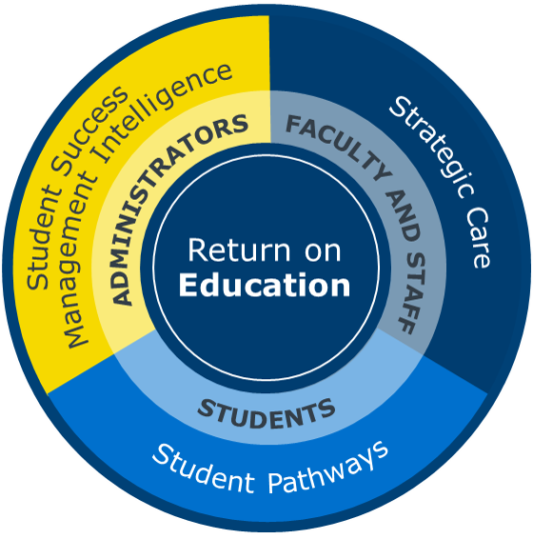
EAB’s Student Success Management System
Proprietary & Confidential
What is a Student Success Management System?
The SSMS is an enterprise-level technology that links administrators, advisors, deans, faculty, other staff and students in a coordinated care network designed to help schools proactively manage student success and deliver a Return on Education.
Our Platform Promise
Unlock the power of data analytics, bringing real-time insights and student success management intelligence to administrators and leaders
Create a connected and coordinated network of support for every student, enabling targeted intervention and proactive, strategic care
Provide curated, intelligent guidance at the most pivotal moments along the college journey, simplifying and structuring student pathways to completion.
Notes:
Take action to find and intervene
with students that need
targeted support
Activate a community-wide care network to enable closed-loop interactions and unparalleled support

Slide 13
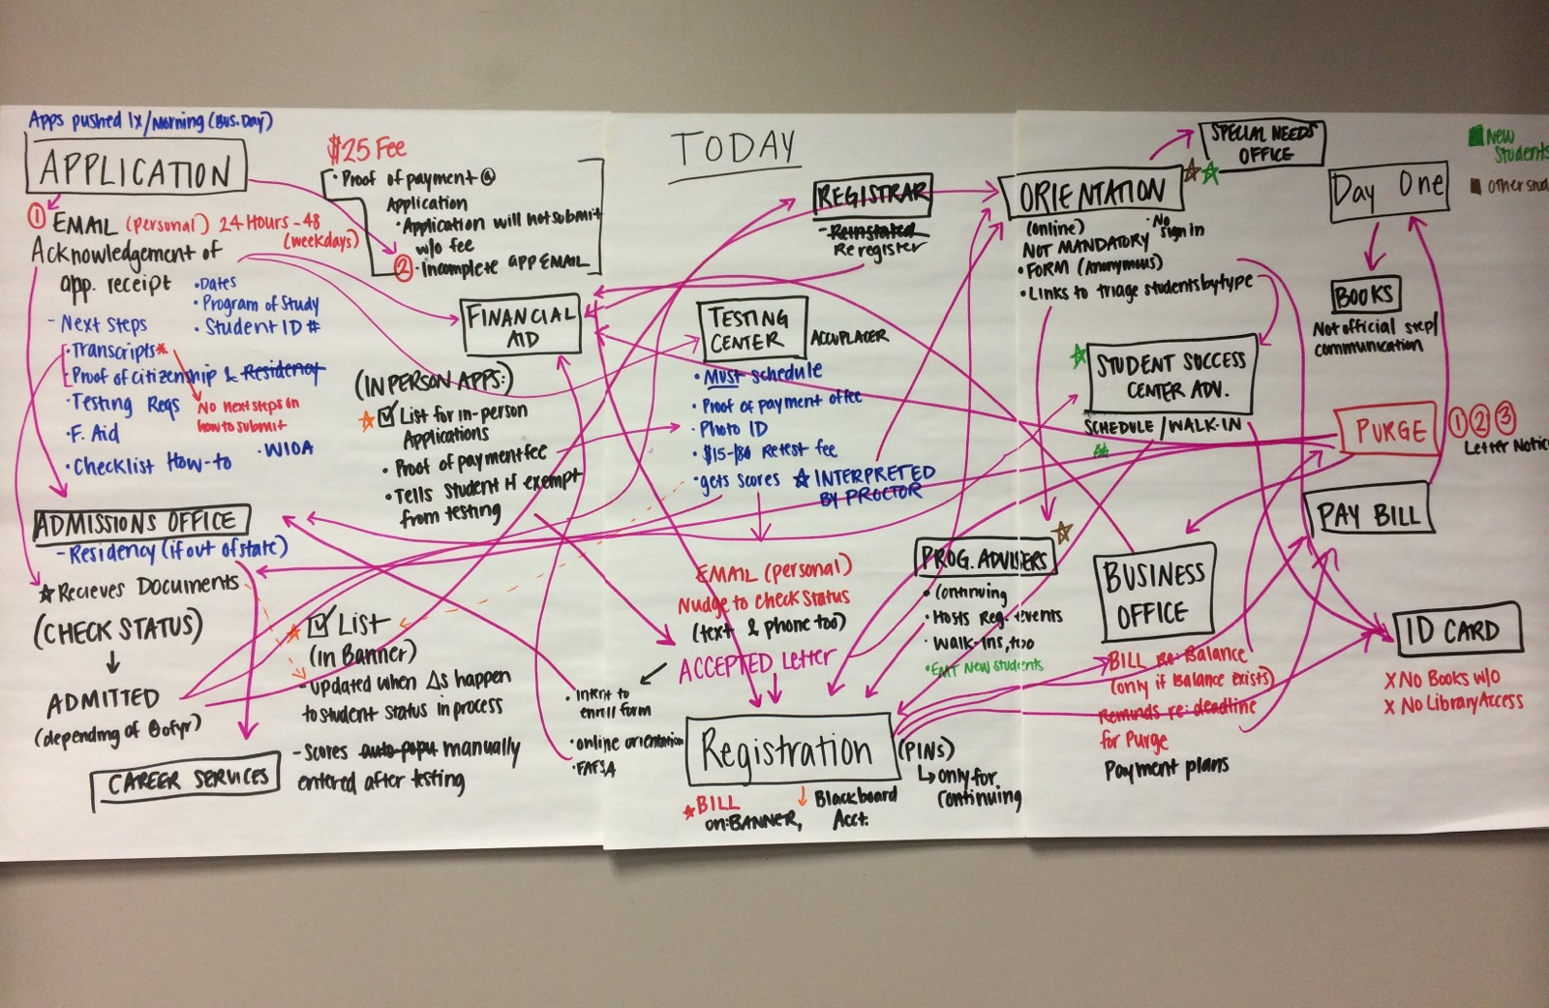
A Real-Life Example – Student Onboarding Process Mapping - BEFORE
Application through to ‘Day One’ – current day

Slide 14
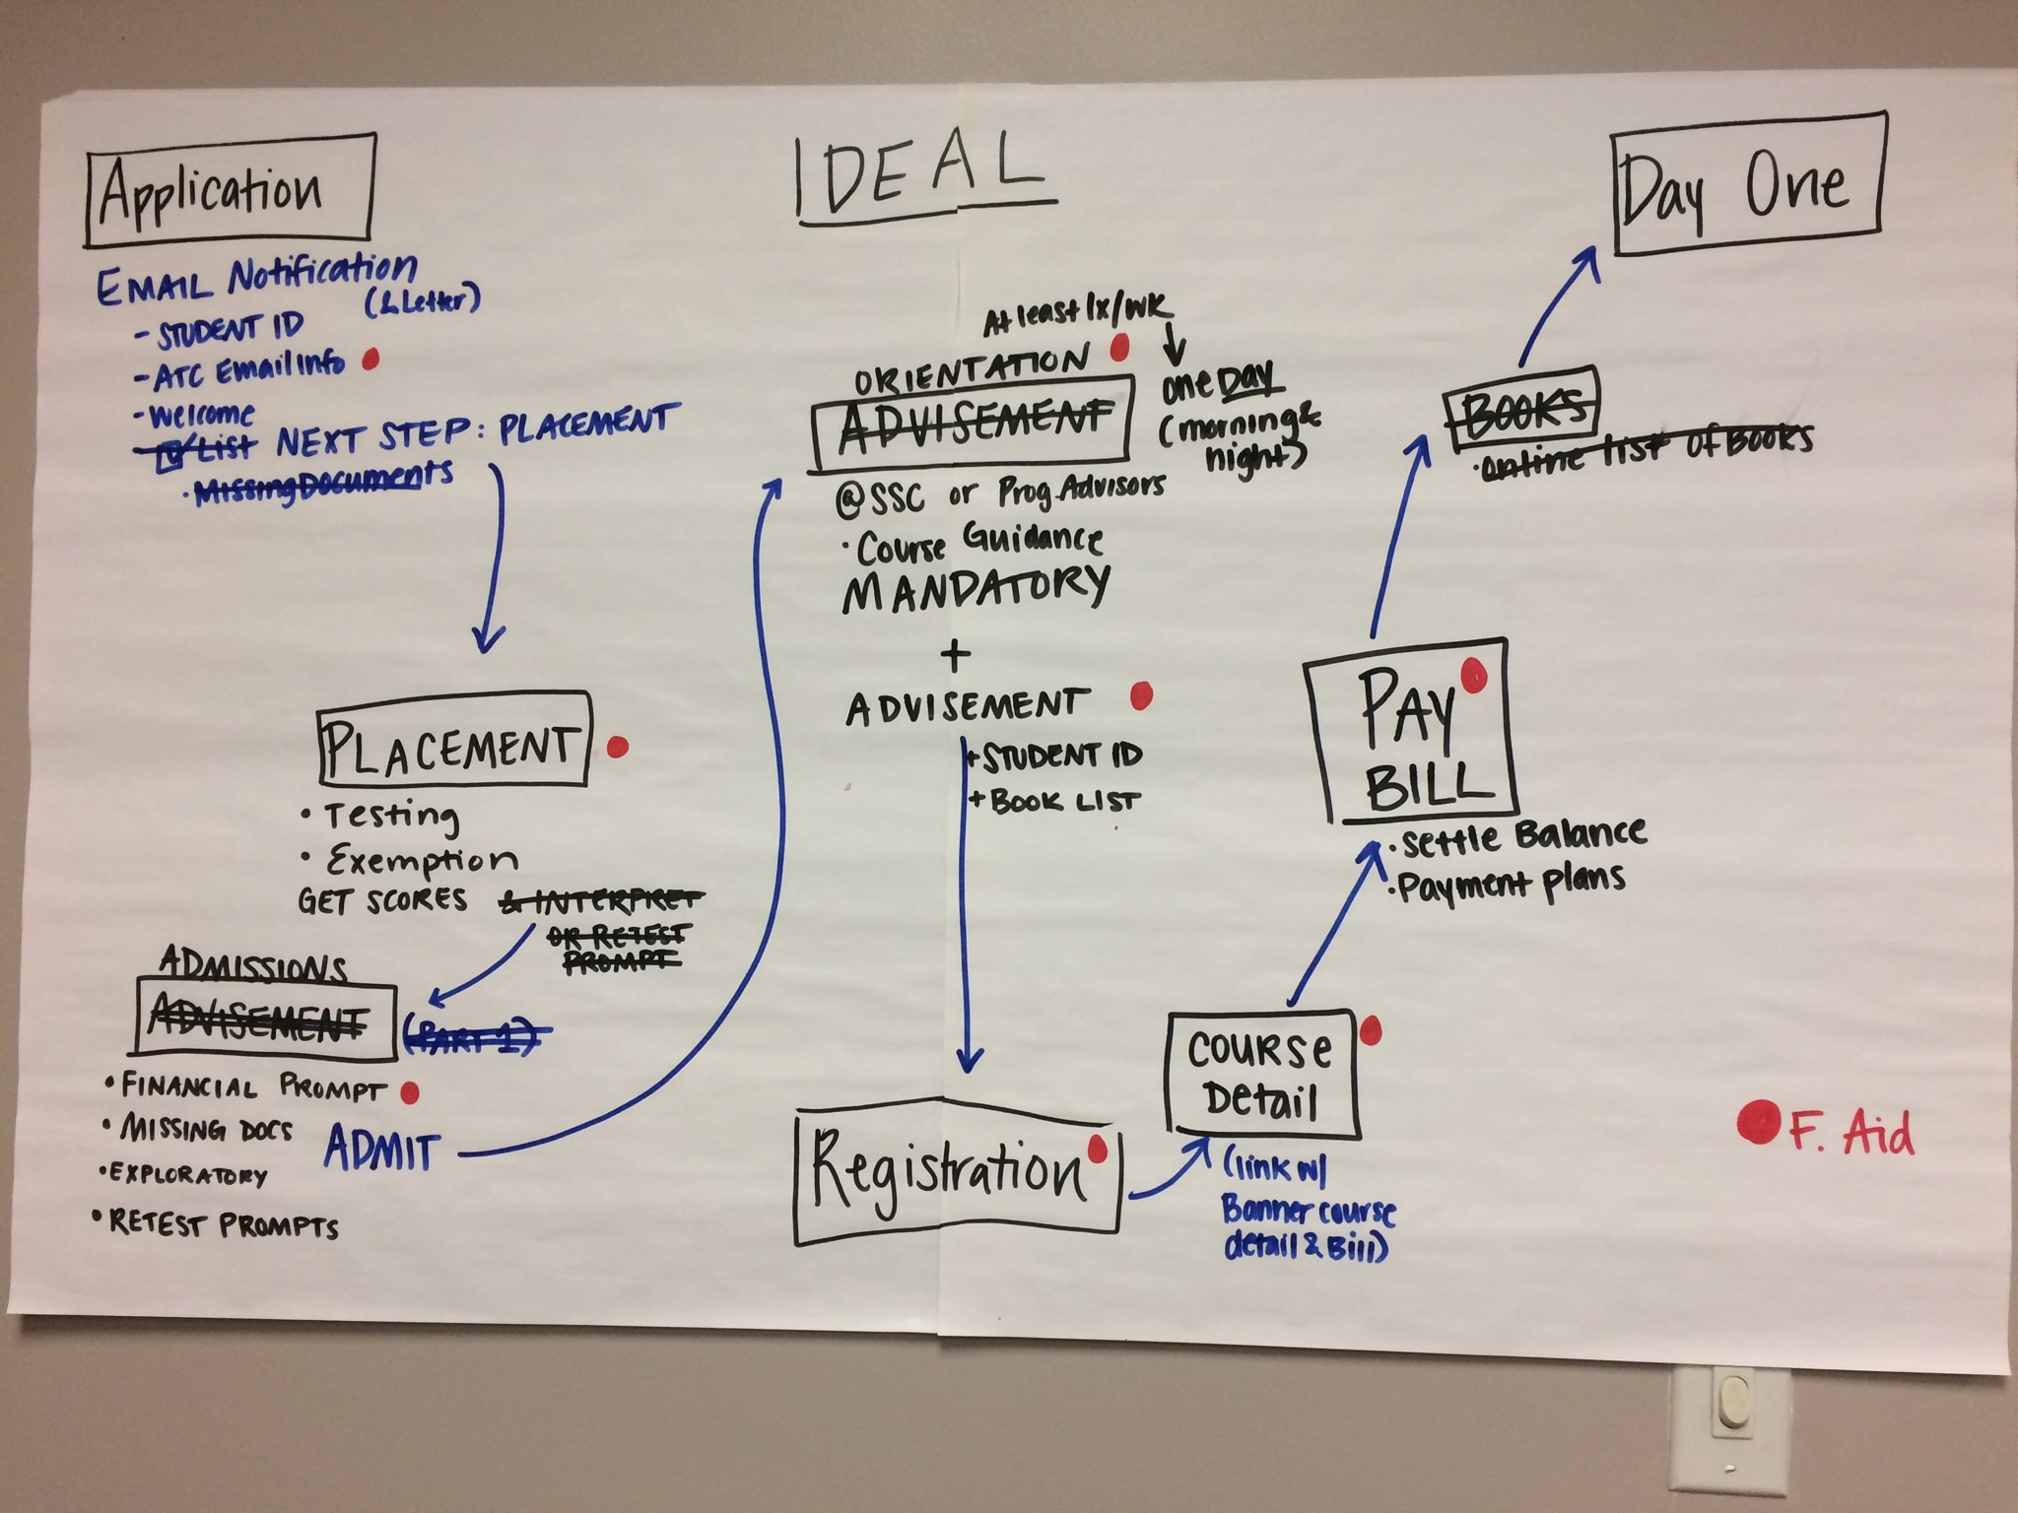
A Real-Life Example – Student Onboarding Process Mapping - AFTER
Application through to ‘Day One’ – ideal scenario

Slide 15



No Such Thing as Plug ‘n Play
Supporting Navigate Members from Concept to Full Launch…and Beyond
Major Phases and Deliverables across the Change Management and Technology Implementation Timeline
SSC Project Timeline
2 months
6 months
9 months
Planning
Designing
and Building
Executing
Ongoing
Representative Activities:
Determine college steering committee members and commence bi-weekly leadership calls with EAB
Schedule and complete kickoff onsite to map institutional processes for onboarding and registration
Complete technical planning call and commence technical implementation
Representative Activities:
Review consultant opportunity assessment from kickoff findings
Initiate strategic communications to campus
Initiate application configuration
Select specific populations for initial user testing and cohorts
Determine launch timeline
Representative Activities:
Conclude technical implementation
Complete application configuration
Commence initial student testing
Campus-wide advisor and staff platform training
Representative Activities:
Initiate campus-wide application launch and sustain ongoing availability
Monitor key utilization and value metrics
Update configurations as appropriate
Identify best practices and areas for improvement
Continued training support
Major Member Deliverables
Enrollment
Pain Point Audit
Technology Ecosystem Audit
Guided Implementation Blueprint
Campus Communication Toolkit
Onboarding performance benchmarking exercise
Identify major barriers to enrollment for focus during change management
Facilitated workshop to identify use and purpose of student technologies
Propose new streamlined technology workflow
Step-by-step work plan outlines key tasks, owners, and due dates for timely platform configuration
Real-time updates on Box
Mass marketing toolkit includes email templates, promotional posters, etc.
All materials customizable to each member campus
Source: EAB interviews and analysis.

Slide 16
APPENDIX

Slide 17
The Evolution of Student Success Best Practices
EAB Research Tracking the Past, Present, and Future of the Field
EAB’s Unparalleled Expertise in Student Success
Strategic Fin Aid
2010s
The success challenge dramatically expands in scope as a result of the Great Recession
10+
Career Dev
Years of research
Degree Progress
20+
Studies completed
200+
Next-Gen Advising
Published best practices
Dev Ed Reform
2000s
Advent of early warning systems and other technology-enabled strategies
Degree Planning
Early Intervention
First-Year Experience
Pre-2000
Early strategies focused primarily on student attitudes and the needs of specific populations
Special Populations
Student Engagement
1970
1980
1990
2000
2010
2020
Beyond First-Year Retention:
The Nation’s New Student Success Mandate
1
Improve Access
2
While Graduating More Students
3
In Less Time
(and at Lower Cost)
4
And Ensuring a Positive Post-Grad Outcome
Our Mission is to Generate a “Return on Education”

Slide 18










What Is a Coordinated Care Network?
People
Advisors, administrators, faculty, career services, financial aid, counseling, tutoring services,
residence life
Process
Note taking and sharing standards
Referral and transition policies
Coordinated support and communication processes
Technology
Tracked communications
Shared documentation
of service interactions
Case management
Progress reports and alerts

Slide 19






Why We Succeed Where Others Fail
Our Dedicated Consulting Team Starts Working from Day One to Create a Self-Sustaining Student Success Initiative and Drive Continuous Progress at Your Institution
Sample Consulting Activities During SSC Implementation
Organizational Readiness
Student Success Strategy
Data-Driven Decision Making
Your dedicated consultant will work with you to evaluate your institution’s overall readiness for the SSC initiative, identify potential barriers, and develop a customized implementation strategy.
Leveraging extensive student success experience, we will work with you to set appropriate targets, identify key areas of focus, and outline a master plan based on your institution’s unique initiatives and goals.
Your dedicated consultant supports campus leadership in planning and taking action based on insights from current and historical SSC data, creating a campus culture that embraces data.
Resources:
Organizational Readiness Assessment
Resources:
Best Practice Research
Resources:
Opportunity Assessment Onsite
Historical Analytics Trainings
Process Optimization
Communications and Leadership
Rollout and Training Strategy
Using discovery conversations and our technology auditing process, your dedicated consultant learns about your current advising and tutoring processes and recommends modifications that integrate SSC—Campus based on best practices.
Your dedicated consultant collaborates with your team to drive initiative momentum through expectation setting, communicating value to
stakeholders, building urgency, and securing campus buy-in.
To ensure a successful launch, your dedicated consultant will work with your team to identify the highest potential pilots, plan user training, and set utilization expectations and strategy.
Resources:
Advisor Survey
Advising Technology Workflow Optimization
Resources:
Communications Planning Toolkit
Kickoff Onsite
Resources:
Pilot Selection Data Analyses
Best Practices and Case Studies

Slide 20
Accelerating the Pace of Progress
Progressive Institutions Turning to Real-Time Process Improvement to Speed Innovation and Results
Speeding Up the Innovation Cycle
Most Success Practices
Focus on Annual Change
Emerging Practices Focus on Immediate Gains
Applicant to Enrollee Conversion Rates
FAFSA submissions
Onboarding requirements timely compliance
Timely registration
Program changes before add/drop
Less students with holds/quicker resolution of holds
Frequency/type of advising office utilization
Utilization of campus resources
First Year Persistence
Term to Term Retention
Graduation Rates
GPA
Course Redesign
Initiative Launched
Impact
Assessed
Real-time data
speeds innovation
ONE YEAR

