Slide 1
Hiring Top Talent
Part III: Creating an Evidence-Based Hiring Process (Vol. 2)
Independent School
Executive Forum

Slide 2



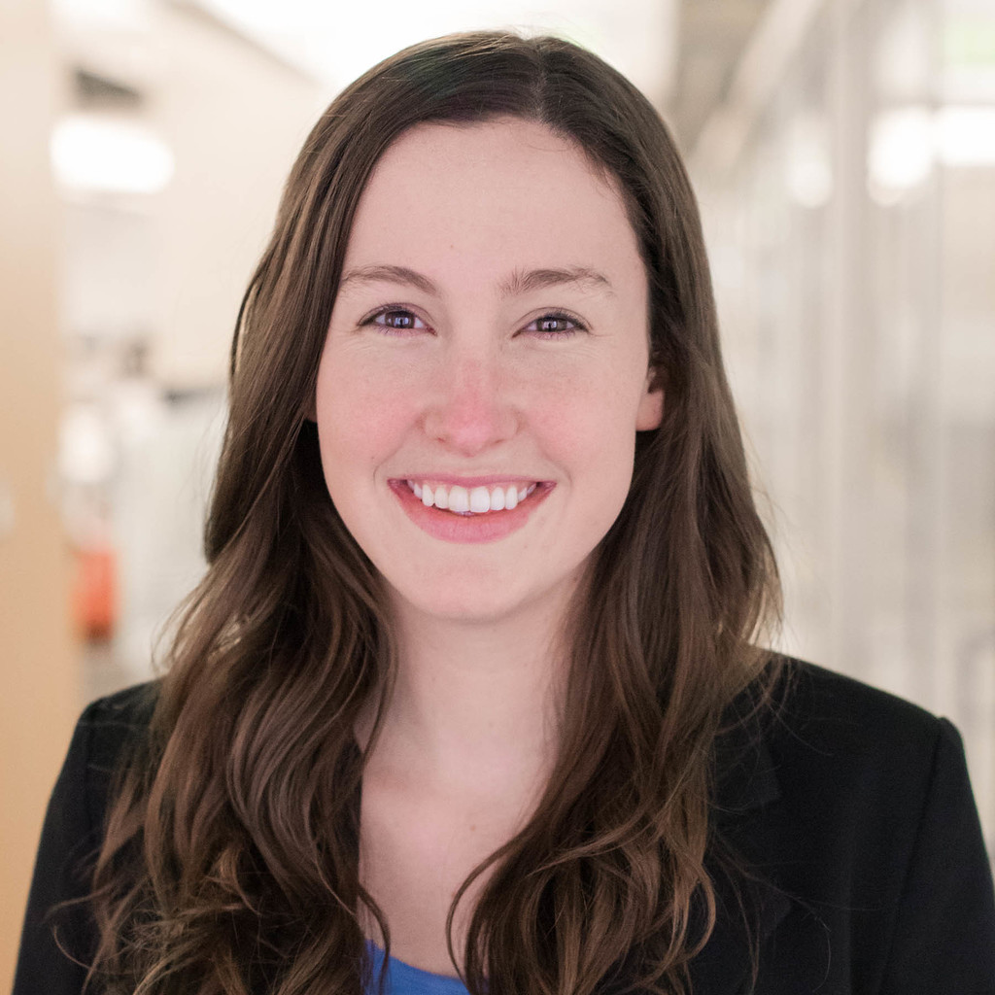

Today’s Presenters
Jo Connelly
Analyst, Strategic Research
EAB
Dr. Delvin Dinkins
Assistant Headmaster
The Pingry School

Slide 3
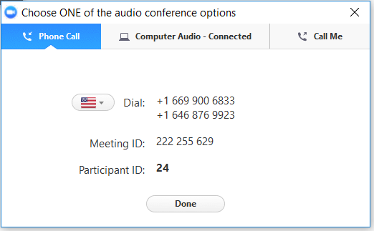
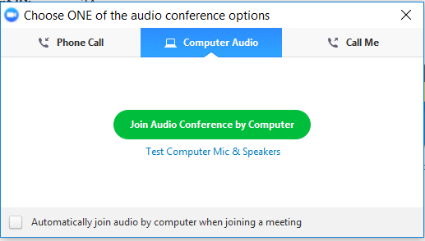
Audio Options
Using Your Telephone
Using Your Microphone and Speakers
If you select the “Phone Call” option, please dial in with the phone number and access code provided.
If you select the “Computer Audio” option, please be sure that your speakers or headphones are connected.

Slide 4


Using Zoom
Mic and Video Controls
Asking a Question
Click the mic and camera pictures until they have a red line indicating they are both off.
To ask the presenter a question, type it into the Q&A panel and press send.

Slide 5
Hiring Top Talent
Join Us for Our Full Webconference Series
Part 1: Laying the Foundation for Effective Hiring
Tuesday, October 1
1:00 PM - 2:00 PM ET
The inaugural session will focus on laying the foundation for effective hiring, including maximizing relevant technology, and on determining assessment criteria at the outset of the hiring process.
Part II: Creating an Evidence-Based Hiring Process (Vol. 1)
Tuesday, October 15
1:00 PM - 2:00 PM ET
The second installment will discuss how to create an evidence-based hiring process. This session will share tactics for designing methods to measure and assess candidates on key criteria throughout the hiring process.
Part III: Creating an Evidence-Based Hiring Process (Vol. 2)
Tuesday, October 22
1:00 PM - 2:00 PM ET
In the third installment the Pingry School will join EAB to discuss their priority-focused interview schedule and how it allows them to assess candidates in the areas that matter most.
Part IV: Attracting New Talent to the Candidate Pool
Tuesday, November 12
1:00 PM - 2:00 PM ET
The final installment administrators at St. Stephen's and St. Agnes School will join EAB to discuss their Educator Open House and how the event helps them connect with a broader candidate pool.
Miss a Session? Want to Share with Colleagues?
All installments of the Hiring Top Talent webconference series are available on eab.com within 24-48 hours of the presentation date. Visit eab.com/hiringtoptalent to access archived presentations.
This four-part webconference series will cover the major themes of our Hiring Top Talent study. During these sessions you and key members of your team will learn strategies for recruiting and hiring great teachers.

Slide 6




Hiring Top Talent
Best Practices for Recruiting and Hiring Great Teachers
1
2
3
4
Lay Foundation
for Effective Hiring
Determine Assessment Criteria
Create Evidence-Based Process
Attract New Talent
to the Candidate Pool
Centralized Applicant Tracking System
Candidate-Centric Recruitment Website
Principles-Based Hiring Criteria
Vacancy-Based Goals
Stage-Specific Assessment Rubrics
Quantified-Feedback Scorecard
Priority-Focused Interview Schedule
Competency Demonstration Exercises
Comprehensive
Hiring Guide
Employee
Referral Incentive
Independent School Recruitment Event
Community-Based Diversity Job Fair
University
Pipeline Cultivation
Diversity
Teaching Fellowship
Source: EAB interviews and analysis.

Slide 7










Hiring Seen as a “Mysterious Dark Art”
Inadequate Hiring Methods Exist Across Industries
Common Approaches to Hiring
The Art Critic
The Sponge
The Prosecutor
The Suitor
The Trickster
Relies heavily on gut instinct
Involves too many people in interviewing
Questions aggressively, tries to stump, trip up
Focuses on selling candidate on the job
Incorporates “tests” for certain behaviors
The
Animal Lover
The
Chatterbox
The
Psychological & Personality Tester
The
Aptitude Tester
The
Fortune-Teller
Uses personal favorite questions
Defaults to light, familiar topics of conversation
Focuses on results of personality tests
Prioritizes aptitude over all other traits
Asks hypothetical, forward-looking questions
Source: Smart, Geoff, and Randy Street, Who: the A Method for Hiring, Ballantine Books, 2008; EAB interviews and analysis.

Slide 8
Schools Fall Under Same Spell
Independent Schools Guilty of Many of the Same Approaches
Common Independent School Approaches to Hiring
The Art Critic
The Sponge
The Animal Lover
The Chatterbox
Relies heavily on
gut instinct
Overestimates own ability to accurately read people
Involves as many perspectives as possible
Wants as many people as possible to help gather information
Uses personal
favorite questions
Includes questions that lack relevance but they deem important
Defaults to light, familiar conversation
Emphasizes
personal connection
“I’ve been doing this for
a long time and think I can spot good teachers”
“We want everyone to
feel like they have a say in the hire.”
“If you could have dinner with any fictional book character, who would it
be and why?”
“I see you went to [insert university] too! Where did you live on campus?”
Solution:
Create, provide rubrics to focus interviewer assessment on areas, criteria that matter most
Solution:
Maximize stakeholder involvement by creating
a schedule, sessions that focus on priority areas, criteria to assess
Solution:
Develop questions that align with criteria to
help surface evidence from candidates on priority areas
Solution:
Implement process that keeps interviewers focused; provide guides and questions to add structure to conversations
Source: Smart, Geoff, and Randy Street. Who: the A Method for Hiring. Ballantine Books, 2008; EAB interviews and analysis.

Slide 9


Create an Evidence-Based Hiring Process
Use Each Step of the Interview Process To Collect Specific Information
Steps to Create an Evidence-Based Hiring Process
Develop Methods to
Measure, Assess Criteria
Map New Criteria to Interview Activities
Create Documented Hiring Process
Design a process that
covers priority areas across interview process
touch-points
Create rubrics, assessment tools to ensure interviewers
will assess candidate on pre-determined key criteria
Develop activities, sessions that collect meaningful evidence around
specific criteria
Expand beyond standard one-on-one interviews, demonstration lesson
Document hiring process, provide tools, guidance to support key activities
Train interviewers on standard hiring process
Source: EAB interviews and analysis.

Slide 10
Create an Evidence-Based Hiring Process
Use Each Step of the Interview Process To Collect Specific Information
Steps to Create an Evidence-Based Hiring Process
Develop Methods to
Measure, Assess Criteria
Map New Criteria to Interview Activities
Create Documented Hiring Process
Design a process that
covers priority areas across interview process
touch-points
Create rubrics, assessment tools to ensure interviewers
will assess candidate on pre-determined key criteria
Develop activities, sessions that collect meaningful evidence around
specific criteria
Expand beyond standard one-on-one interviews, demonstration lesson
Document hiring process, provide tools, guidance to support key activities
Train interviewers on standard hiring process
Source: EAB interviews and analysis.

Slide 11




All the Right Pieces, But Still Falling Short
Interview Day Fails to Make the Most of Multiple Candidate Interactions
Typical On-Campus Interview Day Incorporates Right Pieces…
... But Fails to Fully Maximize Limited Time with Candidates
Repetitive
Redundant questioning limits the amount of information gathered
Tour of
Campus
Department Interview
Variable
Unwritten, uncoordinated interview protocols lead to gaps in topics covered
Demonstration Lesson
Lunch with Faculty
Inconsistent
Lack of consistent questions, topics addressed makes it difficult to easily compare candidates
Interviews with Administrators
Interview with Head of School
Source: EAB interviews and analysis.

Slide 12






Align Interviews with Institutional Priorities
Tactic #7: Priority-Focused Interview Schedule
The Pingry School Builds Interview Day Around Focus Areas
Design a Thematic,
Priority-Focused Interview Day
Build An Interview Schedule
Determine Priority Areas
to Address
Pingry defined eight focus areas
to cover during on-campus
interview day
Ensure Coverage of All Areas
Every faculty interview day includes a session on each
focus area
Create Scheduling Flexibility
Set questions reduce reliance
on topic-specific stakeholders
Create Guide, Questions for Areas
Relevant stakeholders included in
writing questions for each area
Interview guides includes questions, ratings, feedback prompts for each
focus areas
Focus Each Session
Each interview session covers one focus areas, ensuring that sufficient, relevant information
is collected from candidates
on each
Build Interview Schedule, Teams
Assistant Headmaster creates schedule for each candidate interview, assigns interviewers to focus area teams
Gather Evidence in Each Area
Interviewers provided with about
8-10 questions for each focus area to structure conversation, score candidate responses
Source: EAB interviews and analysis.

Slide 13
Interview Day Covers All Focus Areas
Tactic #7: Priority-Focused Interview Schedule
Candidate Schedule Allows for Full Assessment of Potential Contributions
Sample Interview Day Sessions
7:30 | Arrival/Greeting/Tour
7:50 | Student Life
8:20 | Unbounded Classroom
8:50 | Academic Committee
9:20 | Break
9:45 | Academic Administration
10:15 | Teaching Demonstration
11:25 | Educational and Info Technology
12:00 | Lunch
1:05 | Community Engagement
1:35 | Diversity and Inclusion
2:00 | Break
2:25 | Department
3:20 | Head of School
3:50 | Debrief/Departure
Interview Focus: School Culture, Classroom Environment, Student Relationships
Sample Question: How do you help students who are disengaged or who struggle with course material?
Interview Focus: Post-Classroom Impact, Service to School
Sample Question: What community activities do you participate in that you think enrich your teaching or make you
a more positive community role model
for students?
Source: EAB interviews and analysis.

Slide 14



A Closer Look: Academic Administration
Sample Interview Questions, Interviewers
Interviewers
Interview Focus
Upper School Director
Upper School Academic Dean
Pedagogy, Mindset, Professional Learning
What have you learned from your collages and/or mentors? Students?
What has been your greatest professional challenge, and how have you navigated it?
How have you grown and developed professionally over the last year or two?
How do you think
your teaching could develop further?
What words would describe the tone of your syllabus?
What does
collegiality look like
to you?
Source: EAB interviews and analysis.

Slide 15
Focus Areas Provide Roadmap For Interviews
Tactic #7: Priority-Focused Interview Schedule
Eight Identified Priority Areas, Associated Sample Questions
Interview Team | Interview Focus | Sample Question
Student Life | School Culture, Classroom Environment, Student Relationships | How do you find a balance between close relationships with your students and professional distance?
Unbounded Classroom | Experiential, Global, Immersive and Integrated Learning | Describe a situation in your professional life where you took a risk. What was the outcome?
Academic Committee | Intellectual Engagement, Collegiality, Faculty Culture | What are you reading right now?
Academic Administration | Pedagogy, Professional Learning, Mindset | How do you think your teaching could develop further?
Educational & Information Technology | Innovative Practices, Technology | What role does technology have in your teaching?
Community Engagement | Post-Classroom Impact, Service to School | How would coworkers describe the role you play within a group/team?
Diversity and Inclusion | Cultural Competence, Student Relationships, Classroom Environment | What would you do here to contribute to an inclusive environment, given the diversity of our student body?
Department | Content, Pedagogy, Collegiality | How do you define good teaching?
Source: EAB interviews and analysis.

Slide 16
Thank You for Joining Us!
Please Do Let Us Know If You Have Questions
Jo Connelly
Analyst, Strategic Research
EAB
Dr. Delvin Dinkins
Assistant Headmaster
The Pingry School

Slide 17




Questions about Today’s Material?
Connect with EAB Independent School Executive Forum Experts
Claire Criniti
K-12 Senior Relationship Manager,
Account Management
CCriniti@eab.com
202-747-5012
Jo Connelly
Analyst,
Strategic Research
JConnelly@eab.com
202-747-0804
Connect with EAB

