Slide 1
Responding to COVID-19
Critical Lessons For Effective Online Instruction
March 31, 2020

Slide 2
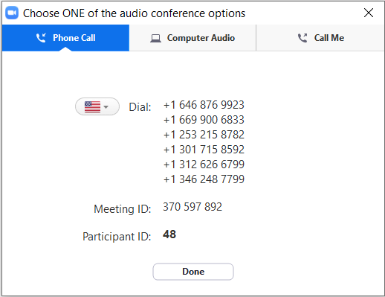
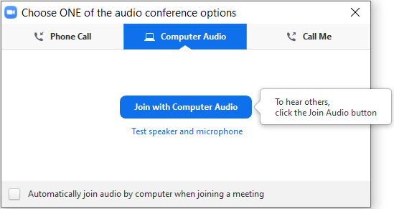
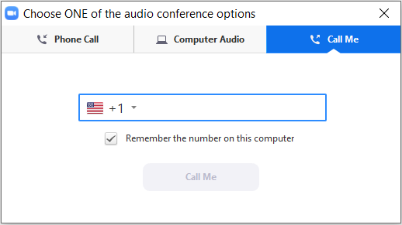
Audio Options in Zoom
Use your computer’s audio and microphone through Zoom
2
Dial in using your phone
1
X
Do not do both – it will cause feedback

Slide 3


Joining Us Today: Brad Rathgeber
We Welcome the CEO and Head of School of One Schoolhouse
Brad Rathgeber, CEO and Head of School
A champion of online learning who believes that
the best classrooms are relational, challenging,
and supportive
A former teacher and administrator at Holton-Arms School in Bethesda, MD, and a higher education advancement officer
One Schoolhouse
One Schoolhouse is a consortium that partners with independent schools to expand learning opportunities for students and educators online. It is a supplemental educational organization that has provided online education for both students and
adult learners for more than a decade. Their mission is to empower learning and transform education by leading through innovation; inspiring learners; and partnering with schools and organizations.
COVID Continuity Resources: https://www.oneschoolhouse.org/covid-19.html
Source: One Schoolhouse, 2020; EAB interviews and analysis.

Slide 4
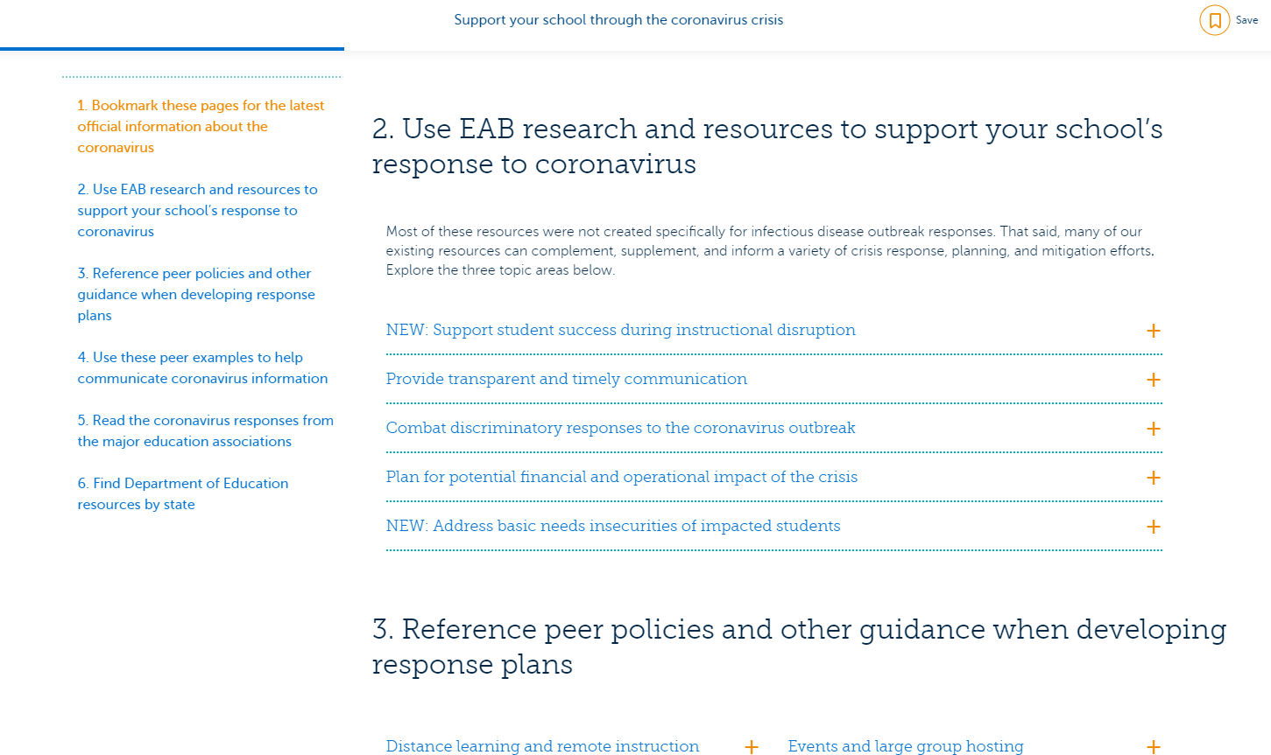
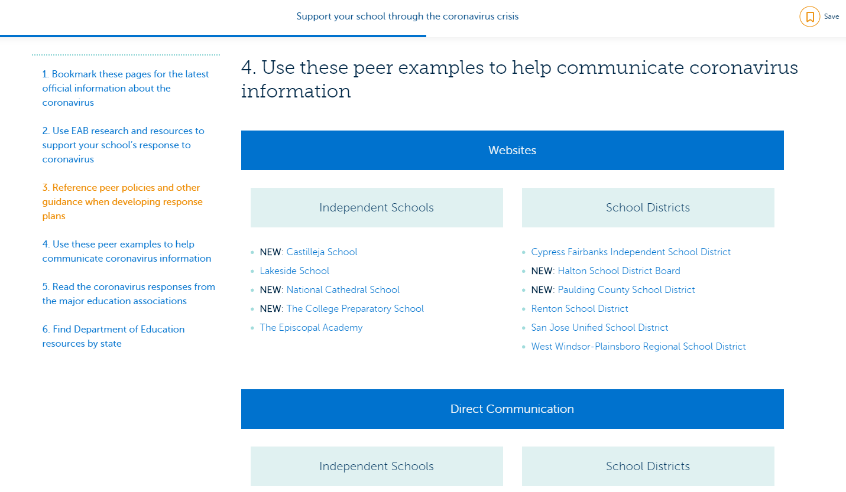

EAB’s COVID-19 Resource Center
Regional and global information hubs, relevant EAB research and resources, responses from major education associations help partners stay up to date and make informed decisions.
District specific examples of comprehensive websites, direct communication, and social media messaging help partners navigate varied communication needs.
To Learn More:
eab.com/K12covid19response

Slide 5



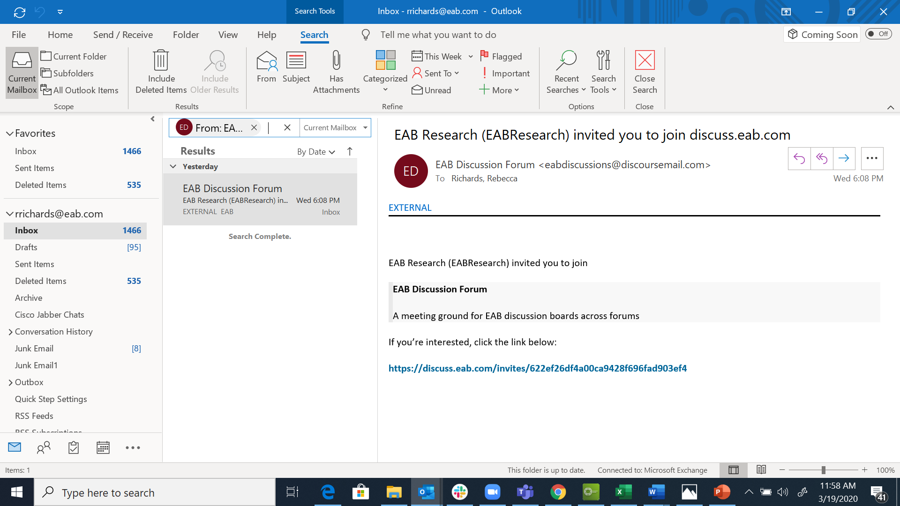
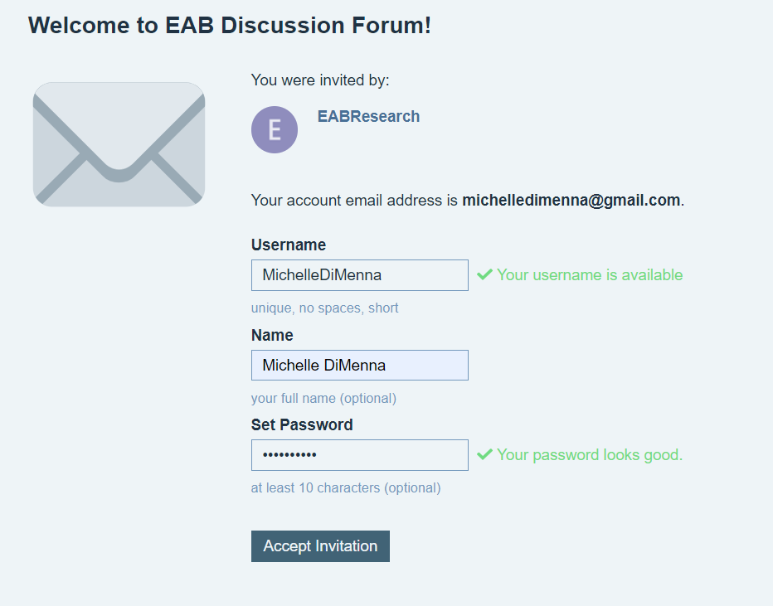
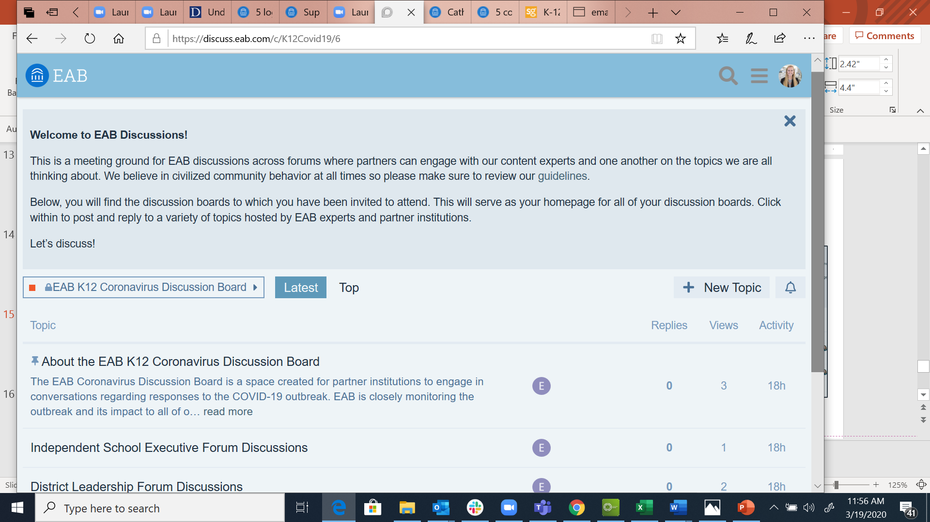
Keep the Conversation Going
Connect with Peers on our K-12 Discussion Board
Invitation email was sent to all main points of contact on Friday, March 20th.
Please email Pete Talbot (ptalbot@eab.com) if you or one of your team members needs to be added to the discussion forum.
1
Access Link in Your Email
2
Create a log-in
3
Join the Conversation

