Slide 1
Using Navigate Insights for Student-Centered Support
Student Success Collaborative

Slide 2
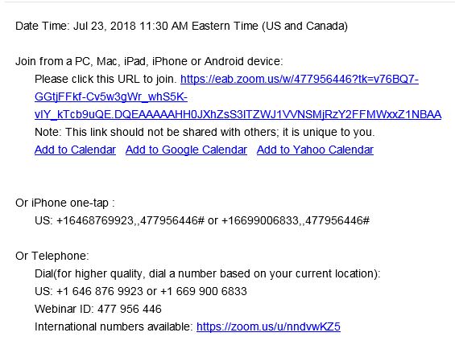
Using Zoom
Audio Options
Refer to the webinar confirmation email you received in your inbox.
Using Your Computer Speakers
If you select the “Computer Audio” option, please be sure that your speakers or headphones are connected.
Using Your Telephone
If you select the “Phone Call” option, please dial in with the phone number and access code provided.
Notes:
Brittany

Slide 3
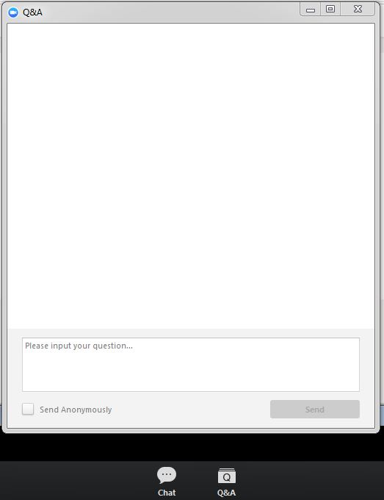
Using Zoom
Asking a Question
To ask the presenter a question, navigate to the Q&A button at the bottom of your screen and type it into the Q&A Panel.
If we are unable to address question live, a member of our team will be in touch to follow-up on your questions individually.
Type your question here
Notes:
You will notice the video and mic options are muted to keep the sound quality as clear as possible. We also want to make sure we follow-up with each individual, so please be sure to type any questions or comments you have into the Q&A box and a member of our team will be in touch. I’m going to try to address as many of your questions as I can during the presentation, but if I miss yours, please note that someone will be in touch with you.
[Presenter to switch slide and begin content]

Slide 4

Meet Today’s Presenter
Ryan Quillard
Strategic Leader,
Student Success
rquillard@eab.com

Slide 5






The When and Where of Navigate Insights
Advanced Search
First Quarter
Second Quarter
Second Half
Population Health Dashboard
Enrollment Census
Attendance
SMD: Program Explorer
Goals and Interests
Progress Report Campaign
Progress Report
Alerts
Cases
Assignments
Surveys
Student Enrollments
Appointments
Appt. Summaries
Activity Dashboard, Reports
SMD: Study Buddies
Enrollment History, Course Data
Student List
Appointment Campaign
Intervention Effectiveness

