Slide 1
Cybersecurity in the COVID-19 Era
How Chief Technology Officers and Superintendents Can Keep Up with Evolving Threats
District Leadership Forum

Slide 2


Today’s Speakers
Meredith McNeill
Senior Director, EAB Research
Ron Yanosky
Director, EAB Research

Slide 3




Please Use the Chat Feature Today!
Specific Questions
Data, Resources, Best Practice Leads
Request to Speak With an EAB Expert
What questions are you tackling that would benefit from additional research?
Share your successes to help other districts better serve their students and communities
Partners: Schedule a consultative conversation through your dedicated advisor
Find the Chat Button at the bottom of your screen

Slide 4







The District Leadership Forum
Comprehensive Support for Superintendents and District Leadership Teams
National Best Practice Research
Tailored On-Demand Research
Diagnostics and Benchmarking
Dedicated Implementation Support
Consultative Decision Support and Guidance
Executive Roundtables and Workshops
P.D. Tools and Implementation Guides
Notes:
We provide District Leadership Forum partners with three pillars of service:
The core our practice is our National Best Practice research, in which we deploy a proprietary research methodology to identify the root drivers of major, systemic challenges in K-12 education, then identify innovative, proven, and replicable practices that will help your team to tackle each one of those root drivers to make meaningful progress against the larger issue.
But some issues are specific to your district’s unique needs, so we also provide tailored, on-demand research to help you make informed decisions and accelerate progress throughout the year
Last, but by no means least, we help districts to understand where they are with regard to key issues through comparing current practices with leading peers and reviewing plans to provide 3rd party validation on key initiatives
Each of these pillars is wrapped in year-round implementation support, through consultative guidance, opportunities to workshop challenges with leaders from across the nation, and toolkits that provide step by step guidance to implement best practices with fidelity

Slide 5













Define Success and Accelerate Progress with EAB This Year
Five Essential Pillars for K-12 Strategy in 2020-21
Serving the Entire Organization
Continuous Learning Resources
Multi-Modal Learning Recovery and Progress
Control Tower
Consultative Workshops
Student and Teacher Mental Health
Maximizing Safe Face-to-Face Learning
Rapid Response Teams
Reopening Plan Validation
Professional Learning Communities
Peer Roundtable Meetings
Transformation Team
Teacher and Principal Retention and Support
Racial Justice and Equity
Principal & Teacher PD
eab.com/k12covidresponse
eabk12communications@eab.com

Slide 6



Objectives for Today
Describe the CTO’s Evolving Cybersecurity Mandate
Identify 8 Quick-Wins to Bolster Security in the COVID-19 Era
Plan Next Steps with EAB for District COVID-19 Cybersecurity Response

Slide 7






Rapid Transition to Virtual Creates Problems for CTOs
Security Risks Intensify in New Virtual Landscape…
…Overwhelming Districts’ Constrained IT Resources
88%
of districts don’t have a dedicated network security person
Ransomware
System Hack
47%
of K-12 IT leaders expect a budget decrease for 2020-2021
Denial of Service
Phishing
“Our small budget is mostly going to new devices or digital learning platforms – there’s almost nothing left for security.”
- CTO, Public K-12 District
Identity Theft
Network Security
Sources: Maylahn, P., COVID-19 Back-to-School Survey Report 2020, CoSN,2020; Maylahn, P., 2018-2019 Annual Infrastructure Report, CoSN, 2019; US Government Accountability Office, Recent K-12 Data Breaches Show That Students are Vulnerable to Harm, 2020; EAB interviews & analysis.

Slide 8
Quick Poll #1
What cyber threat are you most concerned about?
Phishing
Ransomware
Denial of service
Confidential data breach
Network hack

Slide 9

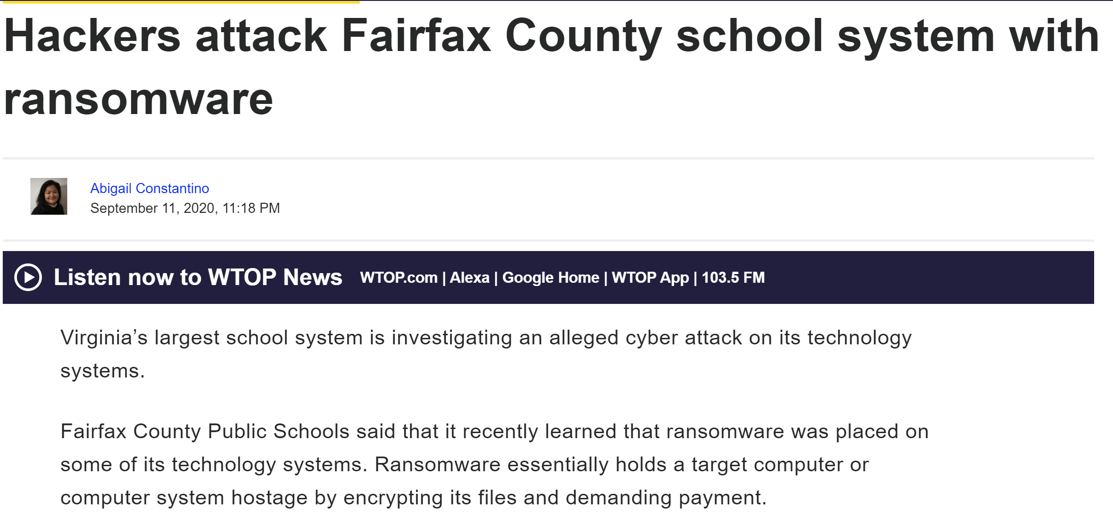
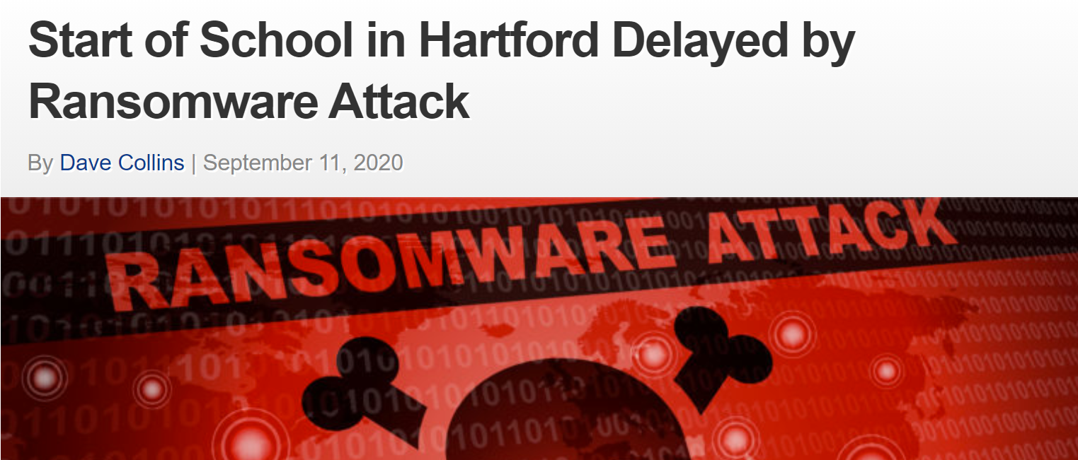

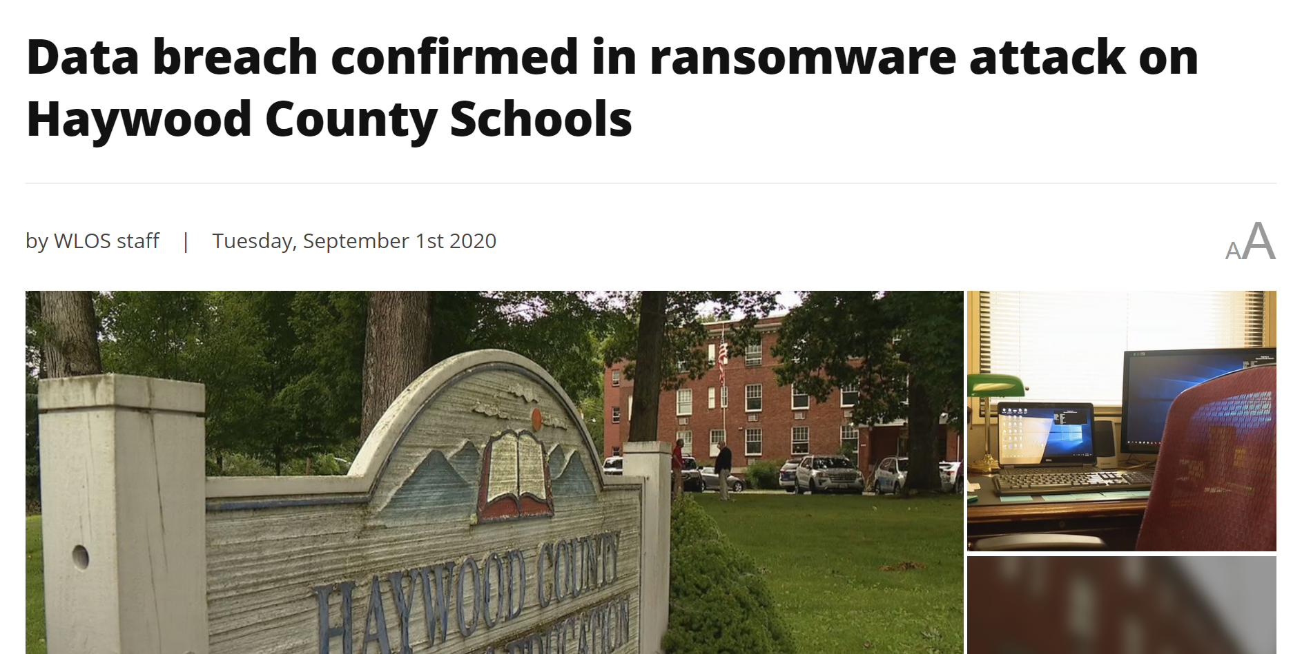
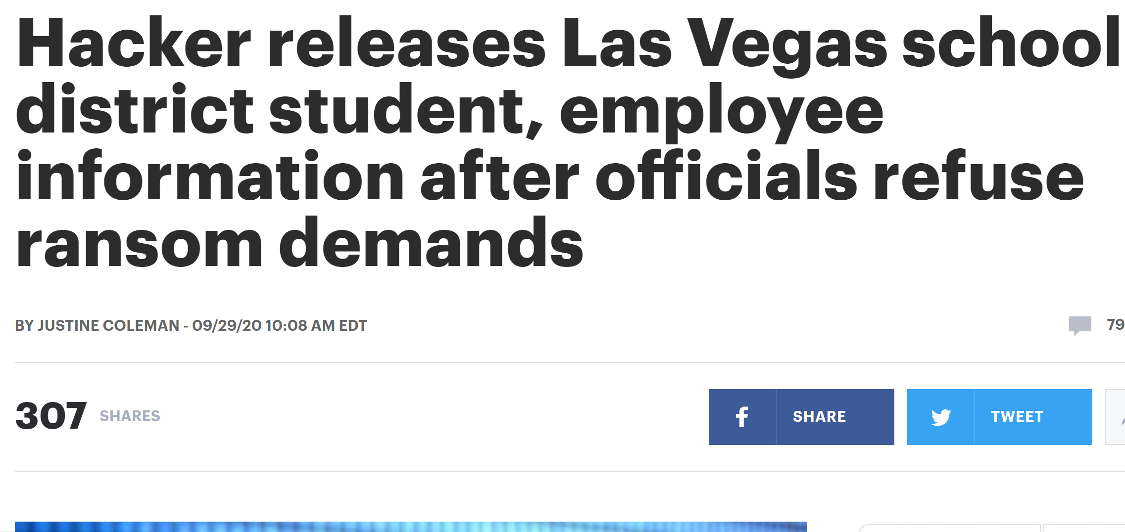
Cyber Attacks on the Rise Since Start of School Year
Pre-COVID Security Trends Worsening Over Time
~60%
of compromised devices are linked to education
30%
increase in back to school suspicious domains in August 2020
Changing Nature Of Attacks on Schools
COVID-phishing scams
Combination of ransomware + data breach/DOS
Sources: Check Point Software Technologies Ltd., Education in a Pandemic: Protect Your Kids from Virtual Back-to-school Threats, 2020; Microsoft, Global Threat Activity, 2020; Perez, J., Hacking the classroom, 2020; EAB interviews & analysis.

Slide 10

Consequences of Attack Higher Than Ever Before
Decreased Community Trust
170x
more inquiries in National Home School Association
Total Halt to School Operations
Shrinking Financial Investment
38%
of K-12 parents nationwide have disenrolled their children from their
original public school
Full shutdowns have led to historic learning loss
“Our school bond failed by a 10% margin, and I think that’s reflective of the COVID environment.”
- School Board President,
West Coast K-12 District
Dependence on tech to keep schools open incentivizes ransomware attackers
Sources: Civis Research, Gates Foundation COVID-19 Tracker Analysis, 2020; Heffernana, J., Ridgefield voters say no to $40.5 million school bond, 2020; Mission, Kan., Interest in homeschooling has ‘exploded’ amid pandemic, 2020; EAB interviews & analysis.

Slide 11
8 Quick Wins for District Technology Leaders
1
Tailor End-User Education to the COVID Environment
2
Stay Up-to-Date on Evolving Cyber Threats
3
Assess Vendor Agreements for Security Compliance
4
Reallocate Funding to Maximize Security Impact
5
Develop and Review Incident Response Protocols
6
Educate Teachers on Data Collection & Retention
7
Use a Tiered Approach to COVID Data Transparency
8
Bolster Your IT Workforce with Students and Volunteers

Slide 12



Tailor End-User Education to the COVID Environment
Quick-Win #1
Remote Teachers and Learners Amplify Need for End-User Security
5x
Employees are 5x more likely to click on malicious links without security awareness training
80%
of security threats are eliminated through end-user education
Advertise 5 Key Elements of COVID-Specific Cyber Hygiene
1
Password management
Cyber Hygiene Marketing Tips
2
COVID-related phishing scams
Short videos reach more viewers than lengthy, didactic engagements
3
Secure Wi-Fi whenever possible
Frame as “personal self-defense” instead of institutional protection
4
Configure software for patch updates
Use existing resources like ConnectSafely Quickguides, Berkeley Extension infographics, NetSmartzKids, or PBS Cybersecurity Nova Labs
5
“Zoombombing” prevention
Source: Pang, A., The IT Investments Securing the Future of Higher Education, 2020; EAB interviews & analysis.

Slide 13




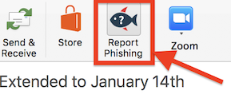

Stay Up-to-Date on Evolving Cyber Threats
Quick-Win #2
Tap into Existing Security & Technology Networks
NATIONAL LEVEL
REGIONAL LEVEL
INDIVIDUAL LEVEL
Cyberthreat sharing portal, emergency notification system, newsletter of trending risks and resources
Monitor local organizations and Regional Information Centers for security trends, resources, and pricing deals
Embed user-initiated reporting systems into everyday tasks
For example:
For example:
Higher-ed focused with valuable cyberthreat trend awareness for K-12
Microsoft Outlook
Michigan Association of Superintendents & Administrators
*Users can also report suspicious messages through a Google Form
(Soon to be launched)
K12-ISAC (Information Sharing and Analysis Center)
Source: EAB interviews & analysis.

Slide 14


Assess Vendor Agreements for Security Compliance
Quick-Win #3
K-12 Vendors Continue to Pose Security Challenges
Measure Vendor Risk in the COVID-Era with a Comprehensive Assessment Tool
Limited or nonexistent breach notification
Two Options:
EAB’s Vendor RFI Template
Vague data retention
& deletion policies
Vendor questionnaire used by K-12 and higher-ed institutions
Simple navigation in one spreadsheet tab
Straightforward format for easy completion by district or vendor
Reluctance to encrypt data in transit
51%
HECVAT Lite from Educause
Detailed cloud vendor questionnaire on information security and data protection standards for higher-ed usage
Includes tabs for analyst reporting, scoring, and rationale
of documented data breaches in 2019 were due to vendor negligence
Sources: EdTech Strategies LLC., The State of K-12 Cybersecurity: 2019 Year in Review, 2019; Educause, Higher Education Community Vendor Assessment Toolkit, 2020; EAB interviews & analysis.

Slide 15


Reallocate Funding to Maximize Security Impact
Quick-Win #4
Funding Priorities
IT Leader Insight
Security Risk
Tools such as end-point detection & response, anti-malware, and monitoring detection & response help ensures broader remote environment is secure
Endpoint Security
High
Identify and Access Management
Tools such as two-factor authentication continuously validate security configuration; especially important for remote staff, more complex roll-out for students
High
Attention to firewalls, etc., of less importance with fewer people using school network
Network Security
Medium
Source: EAB interviews and analysis

Slide 16
Quick Poll #2
What cybersecurity investments have you implemented since March, or plan to implement this year?
(Select all that apply)
Endpoint detection and response
Anti-malware platforms
Managed detection and response
Two-factor authentication
VPN
Data back-ups
Penetration Testing
Firewalls
Other (please clarify in chat)

Slide 17

Develop and Review Incident Response Protocols
Quick-Win #5
Pre-Incident
Incident Response
Systems and Workflow
Mobilizing Response
Breach Notification
Resolution and Analysis
Manage internal communications
Recruit and manage technical team
Prioritize limiting damage
Collect information for analysis and later review
Pull in additional support based on risk level
Collaborate with legal counsel and compliance experts
Pre-draft press release and victim notification language
Identify root cause
Confirm resolution with affected parties
Evaluate response including time taken to identify breach
Incorporate new threat indicators into future planning
Maintain a pool of incident response leaders in IT who have authority to lead a breach response and recruit technical staff with experience in compromised data.
Create a District Incident Response Plan
Reference the NYS RICS Cybersecurity Incident Response Plan to identify key components of a comprehensive plan and reference sample templates
Source: EAB, IT Breach Preparation and Response Toolkit; EAB interviews and analysis.

Slide 18

Educate Teachers on Data Collection & Retention
Quick-Win #6
Schools Have Legal & Ethical Responsibility to Protect Data…
Educate Teachers on Protecting Student Data While Remote
Compliance with FERPA and COPPA laws
1
Update SDP policies to reflect the nuance of teaching online
Maintenance of parent and community trust
2
Explicitly identify new risks to
SDP violations:
Saving a recorded teaching session on personal computers
Using an unapproved digital product that collects student data
Keeping student login information in a shared cloud folder
…Yet Few Teachers Understand SDP Strategies
74%
of schools have a student data privacy policy
3
Train teachers in SDP policies and share regular reminders
25%
of teachers receive SDP training from the district
Sources: Common Sense Media, The Common Sense Census: Inside the 21st Century Classroom, 2019; Sander, C., How to secure K-12 remote learning in the midst of a pandemic, 2020; EAB interviews & analysis.

Slide 19


Use a Tiered Approach to COVID Data Transparency
Quick-Win #7
Balance Privacy with Maintenance of Community Trust
Examples of Safe Data Reporting by School Community Tier
Direct Exposure
Broader School Community
General Public
  Contract tracing reports for affected school community members
  HIPPA or FERPA does not prohibit releasing PII in the event of direct exposure
  Generic notification of COVID spread
  School-specific health screening guidance
  Basic information on case counts
  Report describing planned school response
Tips for Transparency in Public-Facing Dashboards
Prominently feature opening status or alert levels
Include community data on COVID cases
Display when the dashboard was last updated
Sources: Brugal, Davidson-Hiers, Ebert, Fraser, & Langhorne, Despite federal guidance, schools cite privacy laws to withhold info about COVID-19 cases, 2020; EAB interviews & analysis.

Slide 20




Bolster Your IT Workforce with Students & Volunteers
Quick-Win #8
Tap into Local Colleges & Organizations to Source Low-Cost Security Talent
Train Students
Find Volunteers
UW Madison Information Technology Academy
CyberUp Security Talent Pipeline
IT provides technology training and internship opportunities to high school students
Find dedicated security support staff through CyberUp apprenticeship program
Students receive 3-4 hours of cybersecurity training, including hands-on experience, mentoring, and community service
CyberUp pays a portion of apprentices’ hourly wages to partnered employer (school)
Train Students In-House
Offer teachers incentives to integrate cybersecurity into curricula
Market opportunity for students to build resume as volunteers or interns
See cyber.org for free professional development opportunities for teachers
Source: EAB interviews & analysis.

Slide 21


What’s Next from EAB?
Sneak peak of upcoming tech-focused initiatives
Technical Expertise & Advice
Managing Information Risk in the Age of COVID-19:
Q&A with EAB CISO Brain Markham
Project Management Support
Prepare for Budget Season:
A series of toolkits, audits, and assessments for project prioritization
Vendor Management Roundtable: Partnership Strategies for K-12 CTOs and CIOs

